Slide 1

Project Deux
Done By:
Shamim Bhagat
General Assembly Singapore

Slide 2
About My Project
WEATHER BLOG
Page Header:
Climate change is REAL!
Inspiration behind my project:
Watching documentaries on changing weather patterns globally and witnessing them myself.
Changing rainfall patterns
Higher incidence of mosquito borne diseases
Personalinterest in meteorological data forecasting
Aim
To reach out to people to post their own weather related stories and observations in order to raise awareness that climate change is NOT a myth invented by conspiracy theorists.

Slide 3
User Stories
1.Single User blog
Only ONE user can post during any one session
2. Users can sign up with their email address
3.Users can log in with their email address and password
4.A dedicated central page where all articles posted by that user are rendered
5.An individual article page where users’ can edit and/or delete their post and netizens can leave their comments.
6.Dedicated pages for creation & submission of new articles and comments.
7.Dedicated pages for users to update their articles.

Slide 4
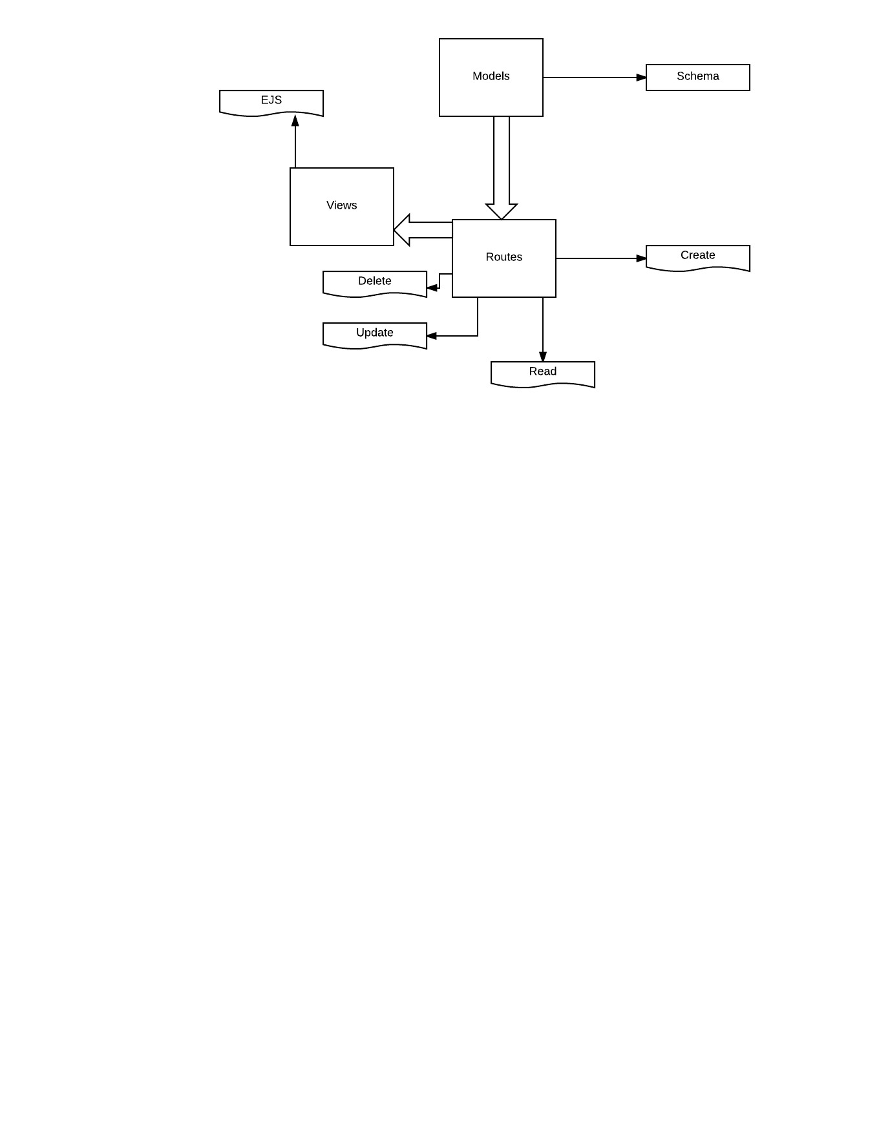
App Features
1.Built using Express.js i.e Sinatra inspired web development framework for node.js.
2.NPM- Node Package Manager
Package manager. Installs, publishes and manages node programs.
3.MongoDB
This is the back-end server user details i.e passwords ,articles and comments are stored as objects
4.Uses mongoose.Js to model node.js data as objects to MongoDB
5.Hosted on Heroku…. Platform-as-a-Service that enables developers to build, run, and operate applications entirely in the cloud.
6.Uses Create,Read,Update,Delete(CRUD) framework to ensure new comments & posts can be created, found, updated and deleted.

Slide 5

Code Planning
User signs up
If user has an existing account, he can log in via the login page
In both cases , he is redirected to the main page
2. User creates a post
routed to a form where he title’s and writes his post
User submits post. Post is stored on mongoDB as an object
User redirected to main page
User views post
User edits or deletes post
User comments on post
User deletes post
User logs out
Passerby netizens leave comments on users’ posts

Slide 6
Files & Their Purposes
- app
------ models
---------- user.js <!-- our user model -->
------ routes.js <!-- all the routes for our application -->
- config
------ auth.js <!-- will hold all our client secret keys (facebook, twitter, google) -->
------ database.js <!-- will hold our database connection settings -->
------ passport.js <!-- configuring the strategies for passport -->
- views
------ index.ejs <!-- show where posts/comments are rendered-->
------ login.ejs <!-- show our login form -->
------ signup.ejs <!-- show our signup form -->
------ articles.ejs <!-- after a user logs in, they will see their posts -->
- package.json <!-- handle our npm packages -->
- app.js <!-- setup our application -->

Slide 7
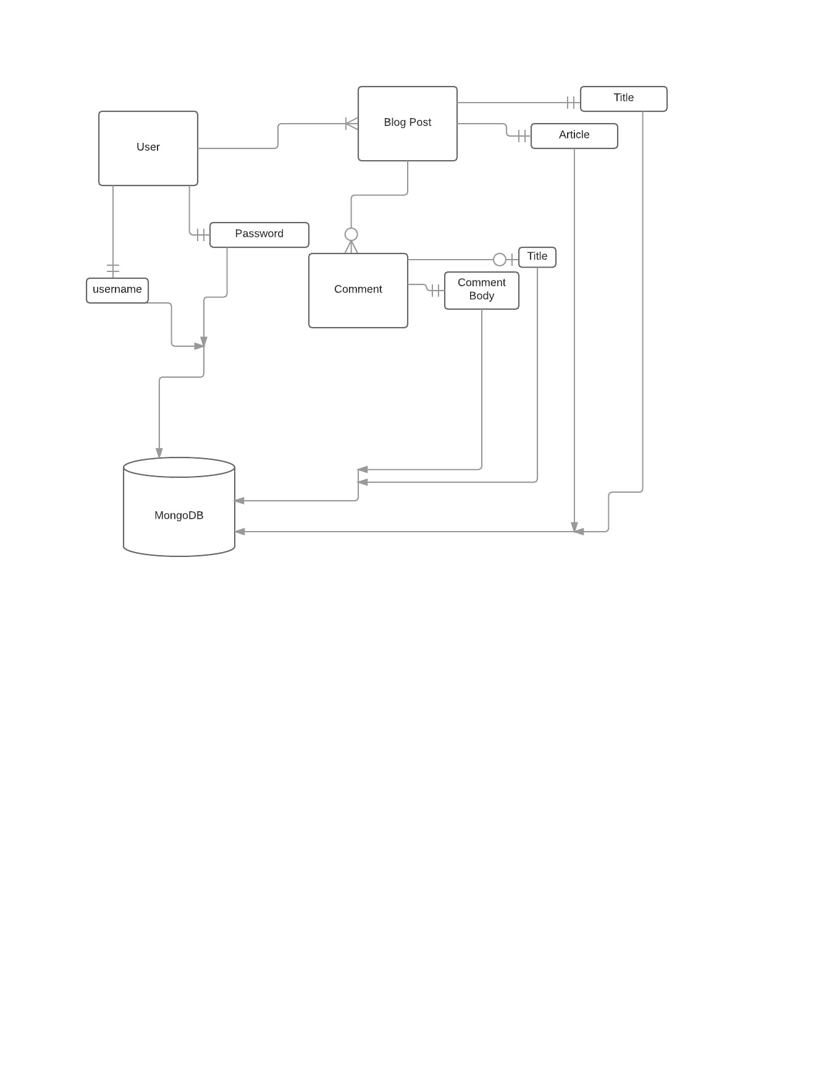
ERD

Slide 8

Difficulties Faced
Many bugs encountered
Built code first before testing functionality
Late Nights
Editing Comments
Delete functionality and API not completed
6.Ensuring good styling
7.Panic attacks
8.Not all express apps are alike

Slide 9
References && Credits
Gitbook
Mozilla Development Network
MongoDB
www.expressjs.com
www.mongoosejs.com
Stack Overflow
Mean Web Development Book
Mr Glen Tan, Mr Prima Aulia Gusta, Miss Tan K L
www.lucidchart.com
Heroku

Slide 10

THANK YOU
& TAKE THE WEATHER WITH YOU

